Slide 1



CASE STUDY OF

Slide 2
INDEX
INTRODUCTON
WHAT IS BREAST CANCER?
REPRESENTATIONOF BREAST CANCER DATA
QUERY TO CREATE TABLE AND INSERT VALUE.
QUERY TO CHECK PERIMETER_MEAN
QUERY TO MODIFY DATATYPE.
QUERY TO UPDATE SMOOTHNESS_MEAN.
QUERY TO WRITE DIFFERENT PARAMETER
QUERY TO COUNT ID.
QUERY TO DISPLAY THE DISTINCT VALUE ORDER BY
QUERY TO DISPLAY THE AVG(),MIN(),MAX(),SUM(),COUNT() FUNCTION.
QUERY TO USE WHERE CLAUSE FUNCTION.
QUERY TO USE LIMIT FUNCTION.
QUERY TO ADD A NEW COLUMN.
QUERY TO DISPLAY THE TOTAL_MEAN.
QUERY TO DELETE THE ID FROM RECORD.
QUERY TO DISPLAY THE HAVING CLAUSE FUNCTION.
QUERY TO USE CONCAT FUNCTION.
QUERY TO USE BETWEEN OPERATOR.
QUERY TO DELETE THE TABLE.
QUERY TO USE DROP FUNCTION.

Slide 3
INTRODUCTION
ID number 2) Diagnosis (M = malignant, B = benign) 3-32)
Ten real-valued features are computed for each cell nucleus:
radius (mean of distances from center to points on the perimeter)
texture (standard deviation of gray-scale values)perimeter
Area
smoothness (local variation in radius lengths)
compactness (perimeter^2 / area - 1.0)
concavity (severity of concave portions of the contour)
concave points (number of concave portions of the contour)
Symmetry
fractal dimension (“coastline approximation” - 1)

Slide 4
What Is Breast Cancer?
Breast cancer is a type of cancer that starts in the breast. It can start in one or both breasts.
Cancer starts when cells begin to grow out of control.
Breast cancer occurs almost entirely in women, but men can get breast cancer, too.

Slide 5
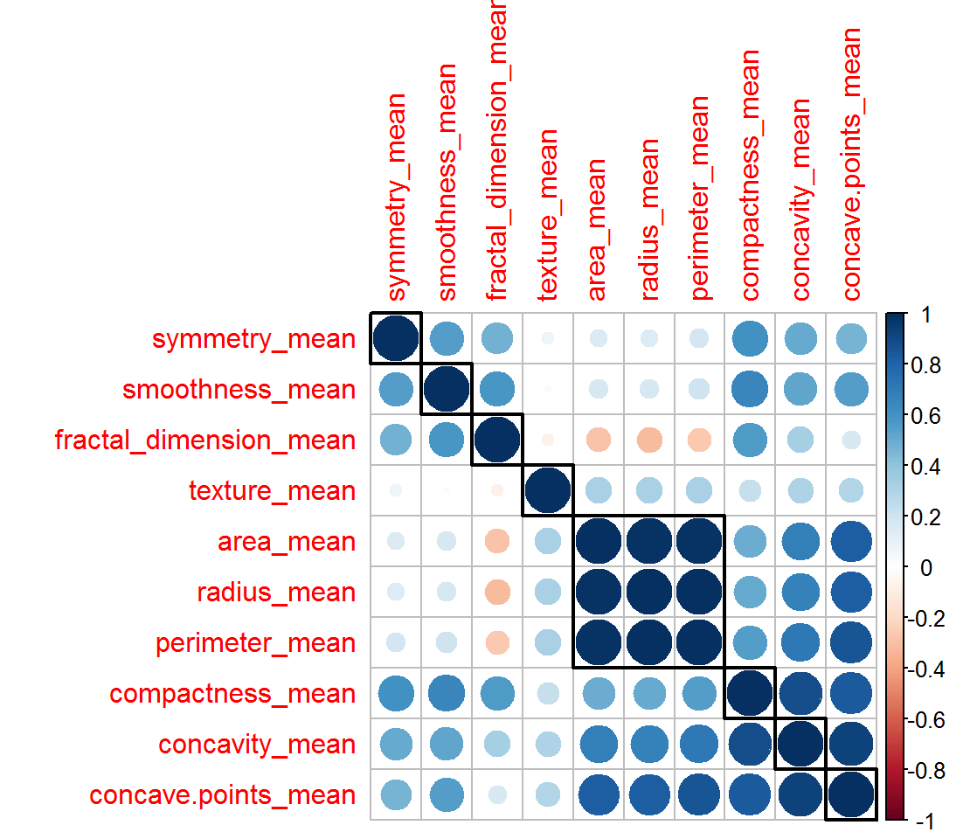
REPRESENTING BREAST CANCER DATA

Slide 6
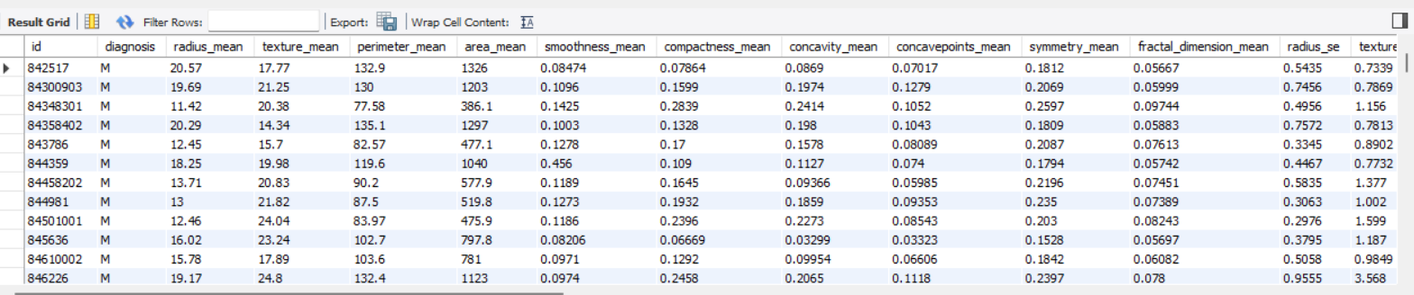
QUERY TO CREATE TABLE AND INSERT VALUE (select * from breastcancer;)

Slide 7
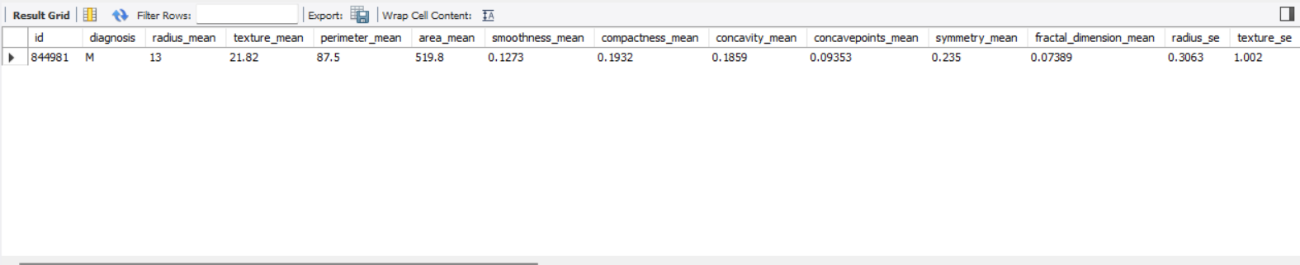
QUERY TO CHECK PERIMETER_MEAN (select* from breastcancer where perimeter_mean=87.5;)

Slide 8
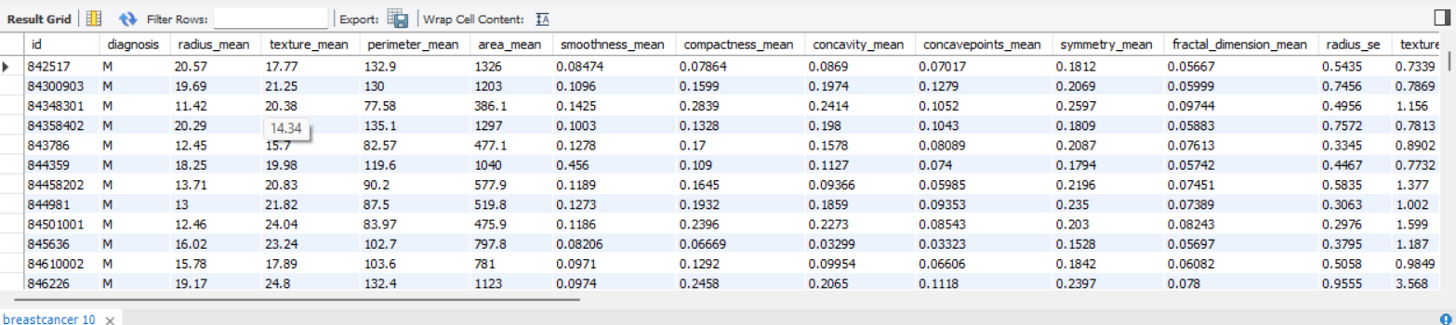
QUERY TO MODIFY DATATYPE (alter table breastcancer modify diagnosis char;)

Slide 9
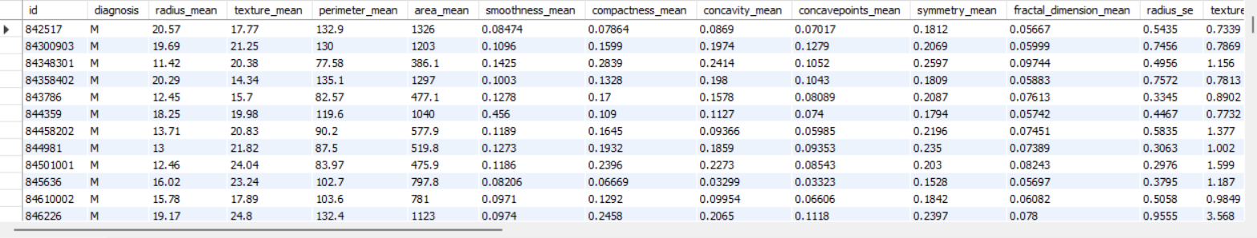
QUERY TO UPDATE SMOOTHNESS_MEAN (update breastcancer set smoothness_mean= 0.456 where id=844359;)

Slide 10
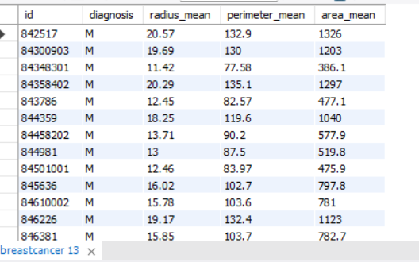
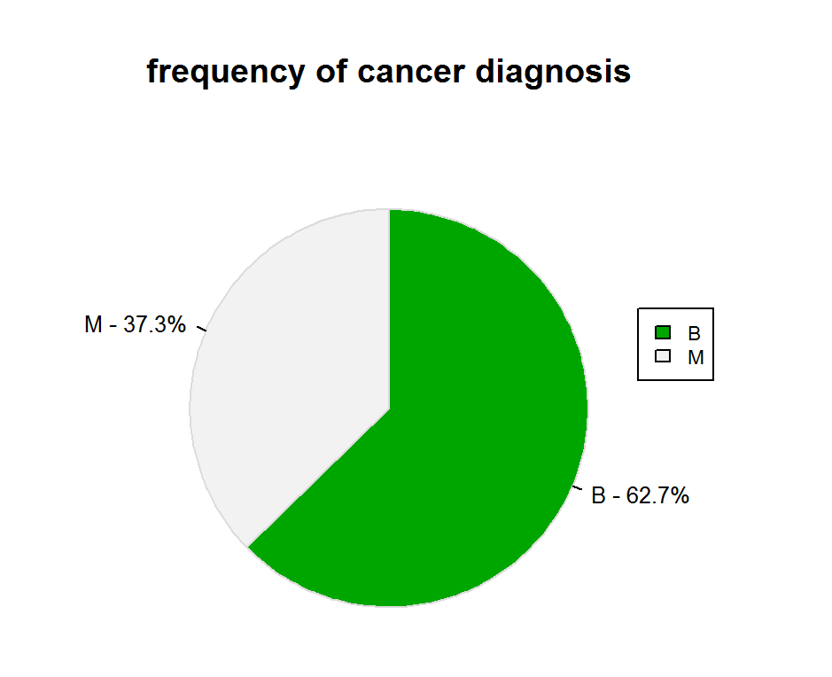
QUERY TO WRITE DIFFERENT PARAMETER (select id, diagnosis, radius_mean,perimeter_mean,area_mean from breastcancer;)

Slide 11
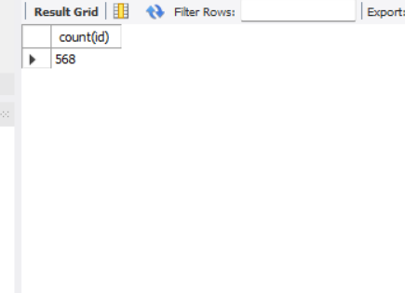
QUERY TO COUNT ID (select count(id) from breastcancer ;)

Slide 12
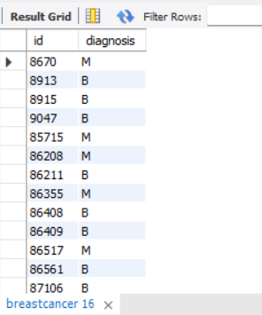
QUERY TO DISPLAY THE DISTINCT VALUE ORDER BY (select distinct id, diagnosis from breastcancer order by id;)

Slide 13
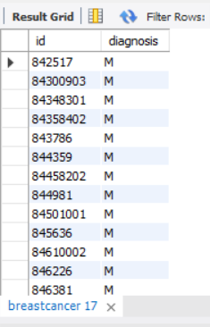
QUERY TO DISPLAY THE DISTINCT VALUE GROUP BY ((select distinct id, diagnosis from breastcancer group by id;))

Slide 14
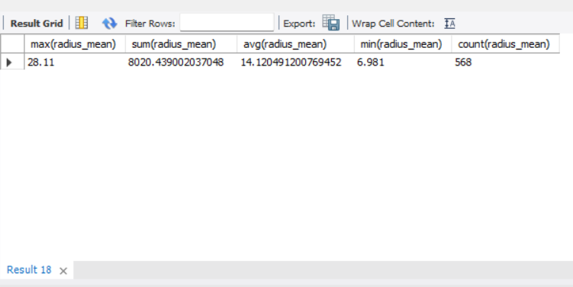
QUERY TO DISPLAY THE AVG(),MIN(),MAX(),SUM(),COUNT() FUNCTION (select max(radius_mean),sum(radius_mean),avg(radius_mean),min(radius_mean),count(radius_mean) from breastcancer;)

Slide 15
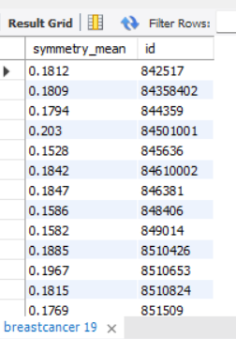
QUERY TO USE WHERE CLAUSE FUNCTION (select symmetry_mean ,id from breastcancer where symmetry_mean<0.2069 group by id;)

Slide 16
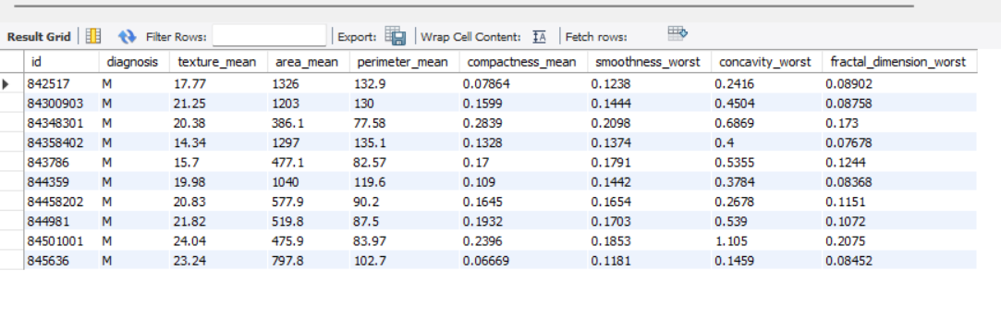
QUERY TO USE LIMIT FUNCTION (select id ,diagnosis,texture_mean,area_mean,perimeter_mean,compactness_mean,smoothness_worst,concavity_worst,fractal_dimension_worst from breastcancer limit 10;)

Slide 17
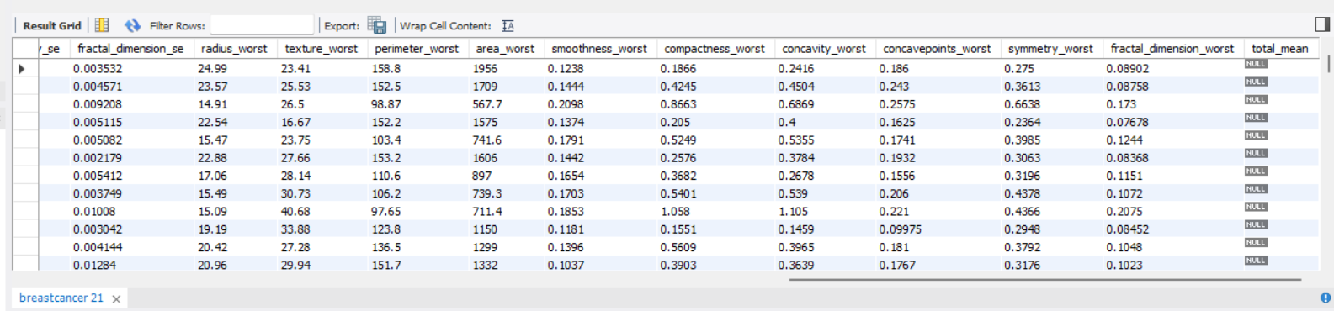
QUERY TO ADD A NEW COLUMN (alter table breastcancer add column total_mean float;)

Slide 18
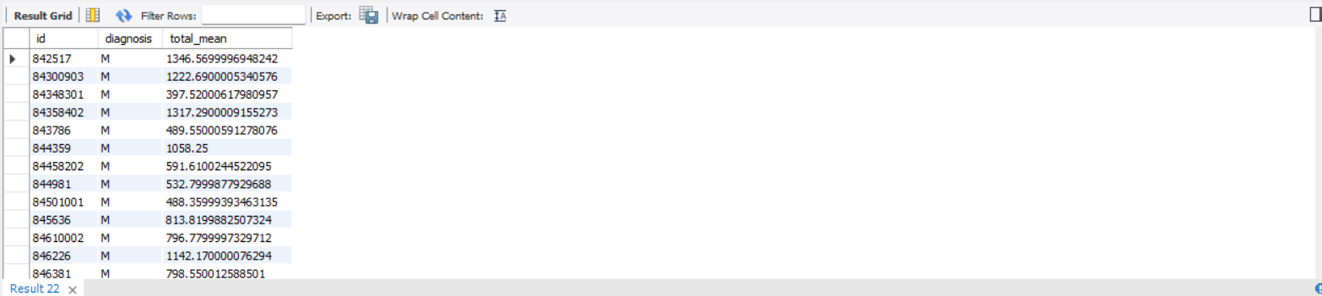
QUERY TO DISPLAY THE TOTAL_MEAN (select id,diagnosis, radius_mean + area_mean as total_mean from breastcancer;)

Slide 19
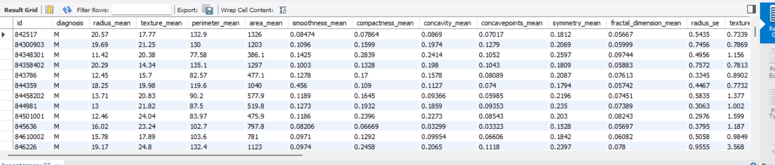
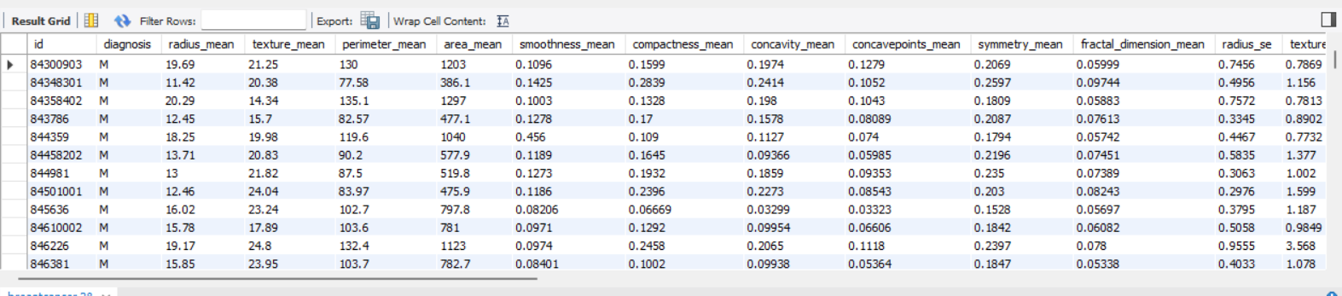
QUERY TO DELETE THE ID FROM RECORD (delete from breastcancer where id= 842517;)
AFTER DELETING THE ID FROM RECORD

Slide 20
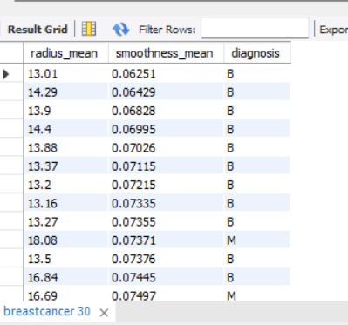
QUERY TO DISPLAY THE HAVING CLAUSE FUNCTION (select radius_mean,smoothness_mean,diagnosis from breastcancer where radius_mean>=13 group by radius_mean having smoothness_mean<=0.456 order by smoothness_mean;)

Slide 21
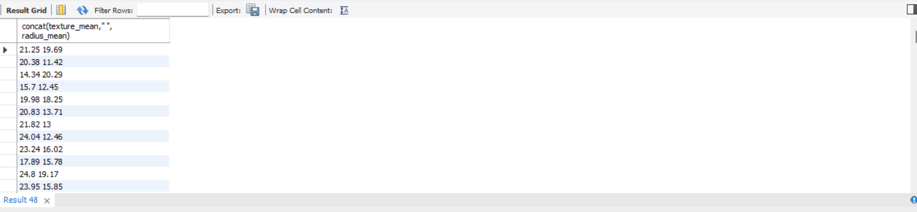
QUERY TO USE CONCAT FUNCTION (select concat(texture_mean," ", radius_mean)from breastcancer;)

Slide 22
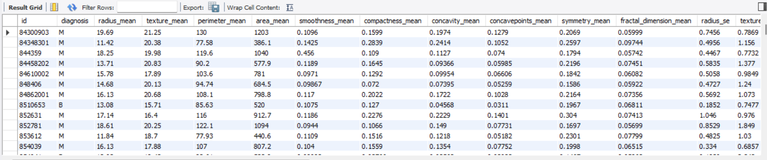
QUERY TO USE BETWEEN OPERATOR (select* from breastcancer where texture_mean between 15.7 and 21.25;)

Slide 23
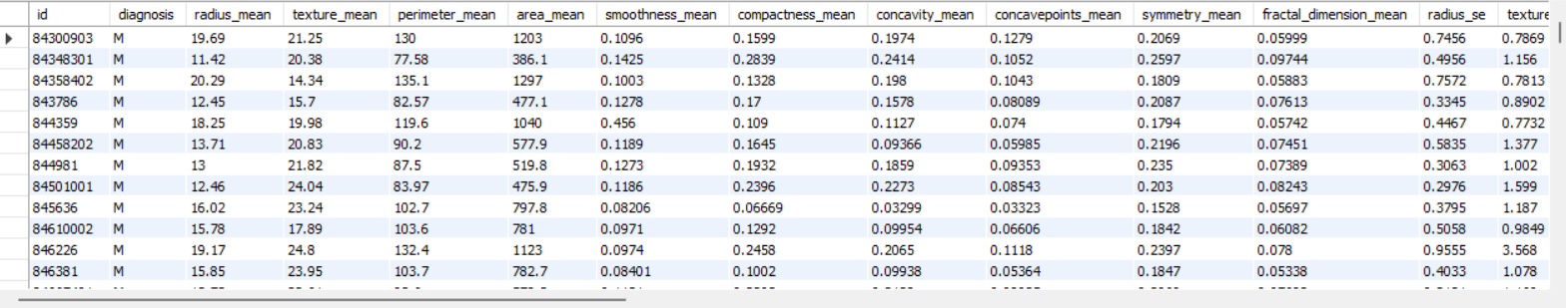
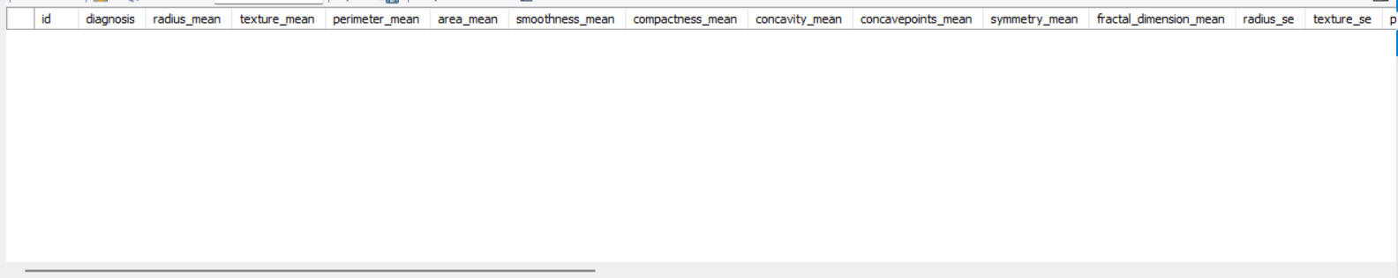
QUERY TO DELETE THE TABLE (drop table breastcancer;)
AFTER DELETING THE TABLE

Slide 24
QUERY TO USE DROP FUNCTION (drop table breastcancer;)
DROPING TABLE SUCCESFULLY

Slide 25


